Slide 1

Introduction
to
Computer Science
CS101.3
Pramudya Thilakaratne pramudya.h@nsbm.ac.lk
Lecturer
Faculty of Computing
NSBM Green University

Slide 2
Module Overview
Module Name – Introduction to Computer Science
Module Code – CS101.3
No of sessions per semester – 15 sessions
Session plan – 14 theory sessions / 1 revision sessions
Module Leader – Mr. Pramudya Thilakaratne
Email – pramudya.h@nsbm.ac.lk

Slide 3
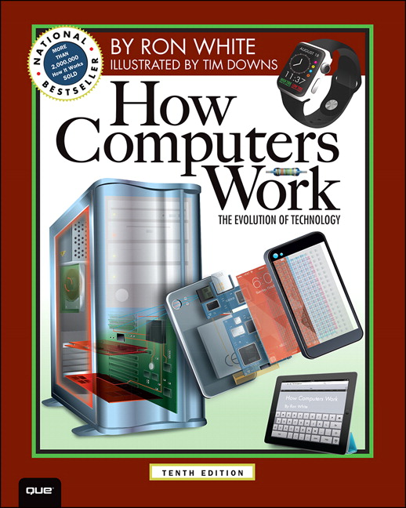
Recommended Textbook for CS101.3
Name How Computer Works
Author Ron White
Latest Edition Tenth Edition

Slide 4

Introduction to Computer Science Evaluation Criteria
Final Exam Paper – 60%
Assignment – 20%
Continuous Assignments – 20%
Take home assignments
Spot tests
In class activities
Total – 100%

Slide 5

Session Plan
Introduction to the module
Number Systems
Binary Number System
Octal Number System
Hexadecimal Number System
Number Representations
Binary Coded Decimal
Zoned Decimal
Packed Decimal
One’s Complement Representation
Two’s Complement Representation
Computer Storage Structure
External Storage Structure
Internal Storage Structure
Introduction to Computer Networking
Introduction to Computer Security

Slide 6
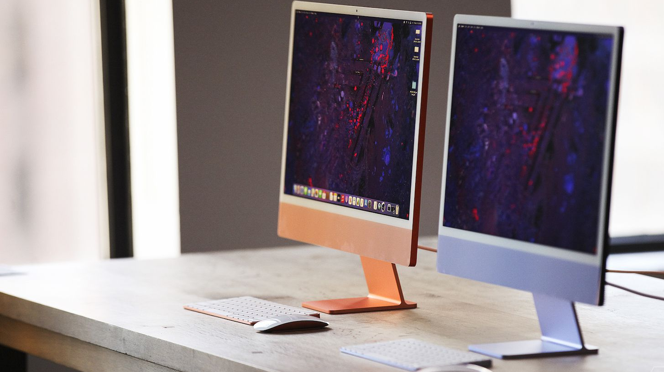
What is a Computer
A Computer is a machine that can be programmed to carry out sequence of arithmetic or logical operations automatically.
Modern computers can perform generic sets of operations knows as programs.
These programs enable computers to perform a wide range of tasks.

Slide 7
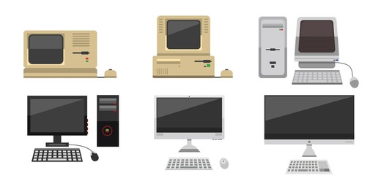

History of Computers
The first counting device was used by the primitive people.
They used sticks, stones and bones as counting tools.
As human mind and technology improved with time more computing devices were developed.

Slide 8
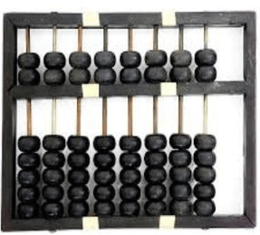
History of Computers Abacus
The history of computer begins with the birth of abacus which is believed to be the first computer.
It is said that Chinese invented Abacus around 4,000 years ago.
It was a wooden rack which has metal rods with beads mounted on them.
The beads were moved by the abacus operator according to some rules to perform arithmetic calculations.

Slide 9
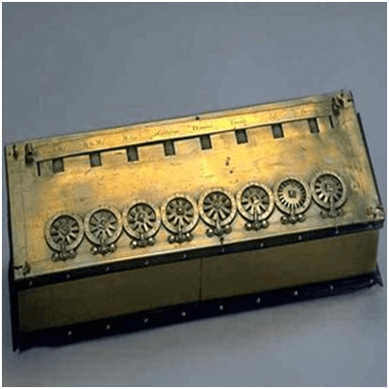
History of Computers Pascaline
Pascaline is also known as Arithmetic Machine or Adding Machine.
It was invented between 1642 and 1644 by a French mathematician-philosopher Biaise Pascal.
It is believed that it was the first mechanical and automatic calculator.
Pascal invented this machine to help his father, a tax accountant.
It could only perform addition and subtraction.

Slide 10
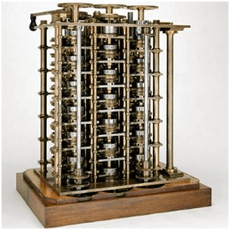
History of Computers Difference Engine
In the early 1820s, it was designed by Charles Babbage who is known as "Father of Modern Computer".
It was a mechanical computer which could perform simple calculations.
It was a steam driven calculating machine designed to solve tables of numbers like logarithm tables.

Slide 11

Quiz
What is the version of the latest Windows Operating System?
Name two other PC based Operating Systems.
What is the latest technology that you know / heard?

Slide 12

Characteristics of a Computer
What is a computer?
Computer is a different type of machine which has,
Speed
ex. High spec computers works faster
Versatility (Scope can be varied)
Computer can be use for certain tasks.
ex. Graphic designing, Web browsing, Word processing etc.
Intelligent
Computer can take its own decisions
ex. ATM machine
Memory
Computer has certain storages
ex. RAM, Hard disk etc.

Slide 13
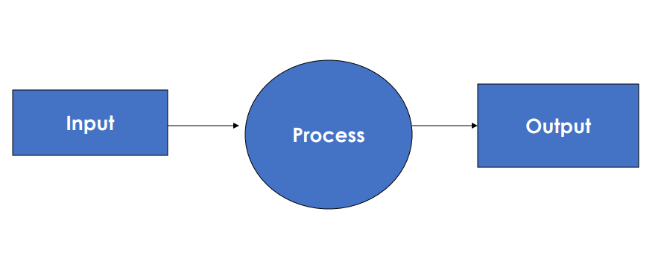
Computer Vs Machine
Architecture of a Typical Machine

Slide 14
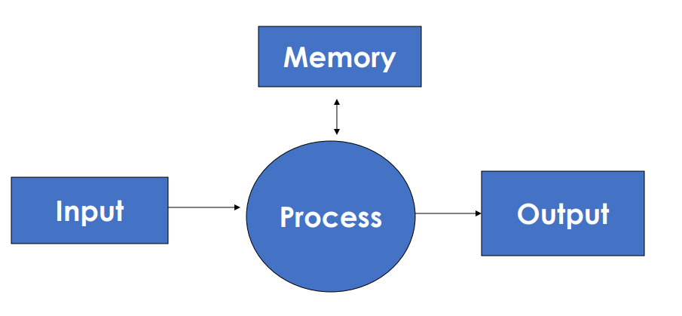
Computer Vs Machine
Architecture of a Computer

Slide 15
Parts of a Computer
Computer consist with two components
Hardware (H/W)
All tangible (Physical) parts of the computer
ex. Cables, Disk, RAM, Motherboard
Software (S/W)
All intangible parts of the computer
ex. MS PowerPoint, MS Word, Web browsers

Slide 16
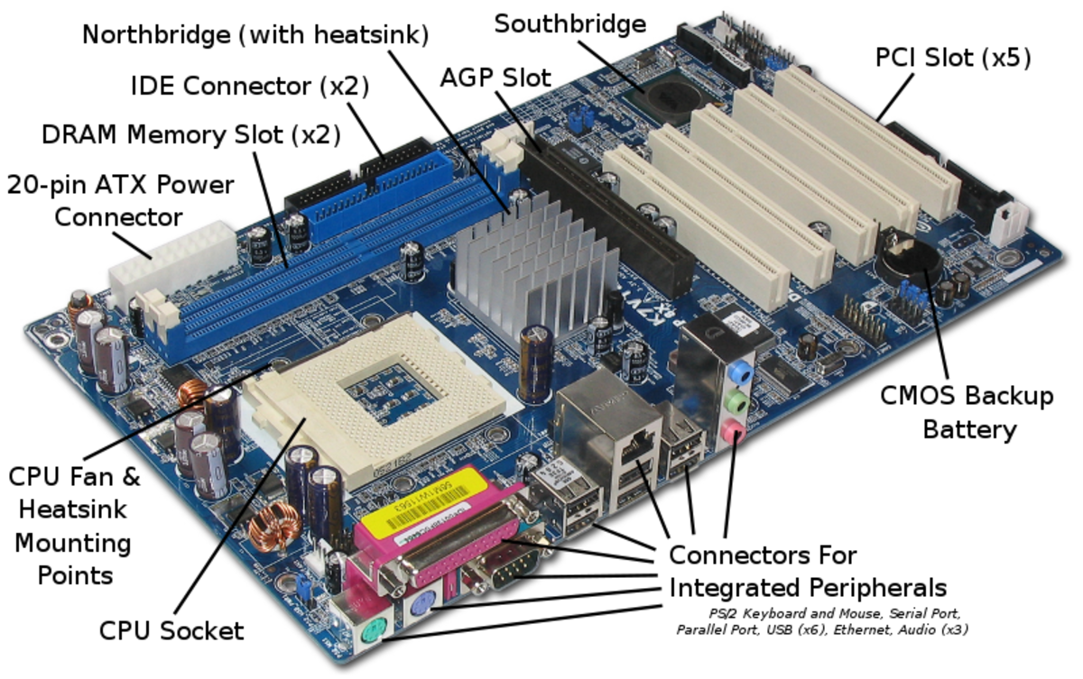
Parts of a Computer
Hardware
Motherboard

Slide 17
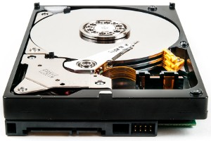
Parts of a Computer
Hardware
Hard Disk Drive (HDD)
A hard disk drive also known as hard drive, HD or HDD is a non-volatile data storage.
It is usually installed internally in a computer, attached directly to the disk controller of the computer’s motherboard.
It connected to the motherboard using an ATA, SCSI or SATA cables.
They are powered by a connection to the computer’s PSU (Power Supply Unit)

Slide 18
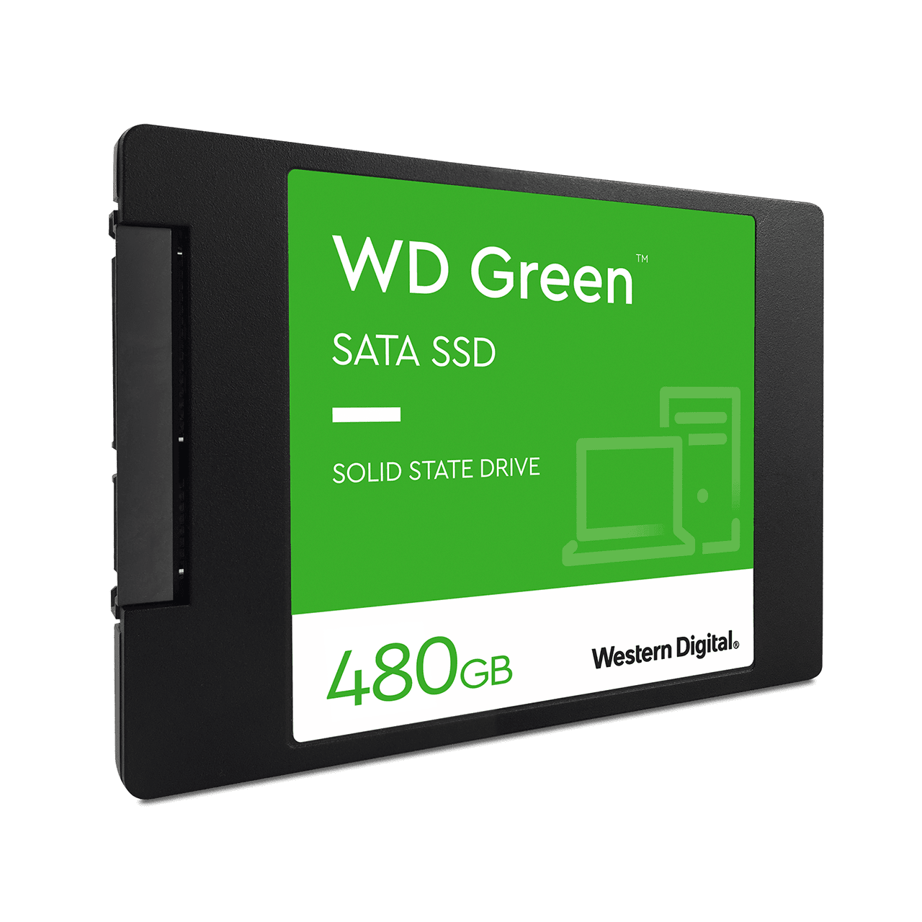
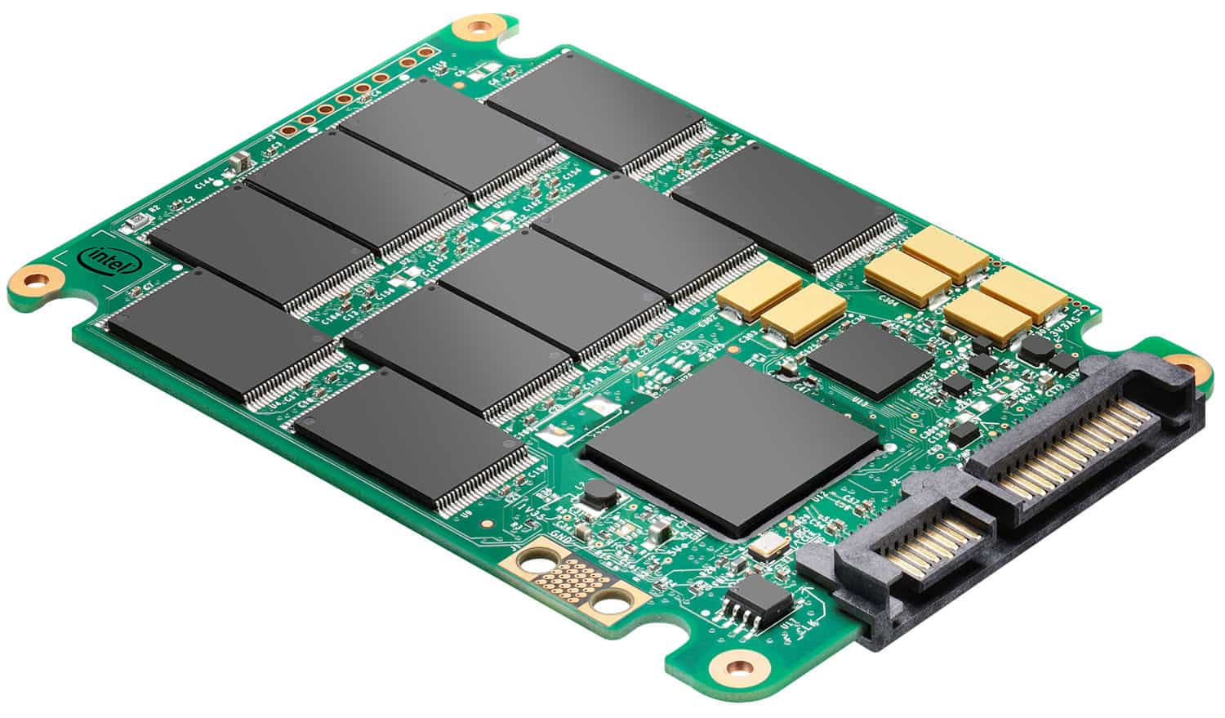
Parts of a Computer
Hardware
Solid State Drive (SSD)
A Solid State Drive is a new generation of storage device used in computers.
SSDs replace traditional mechanical hard disks by using flash-based memory, which is significantly faster.
SSDs speed up computers significantly due to their low read-access times and fast throughputs.

Slide 19
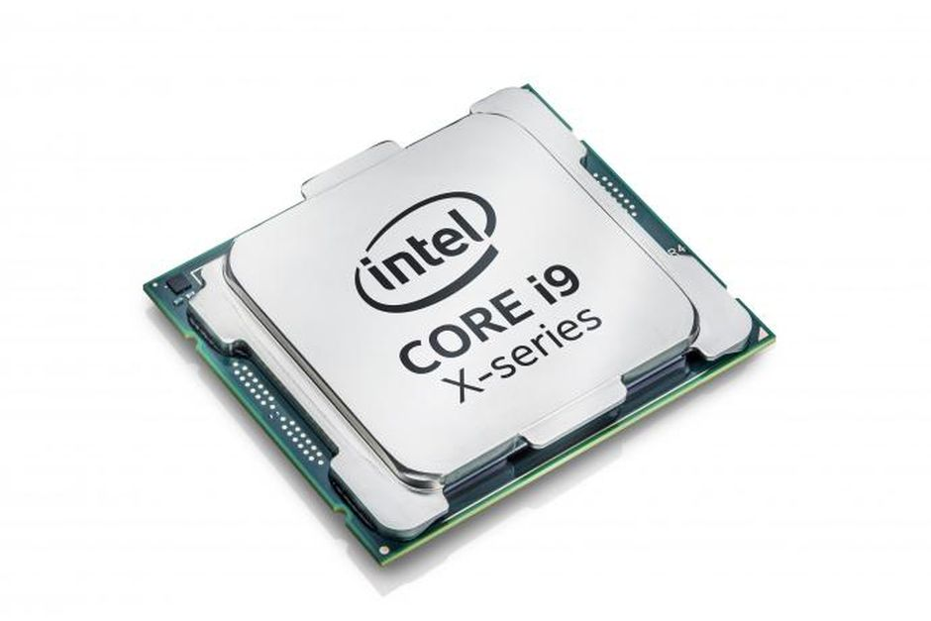
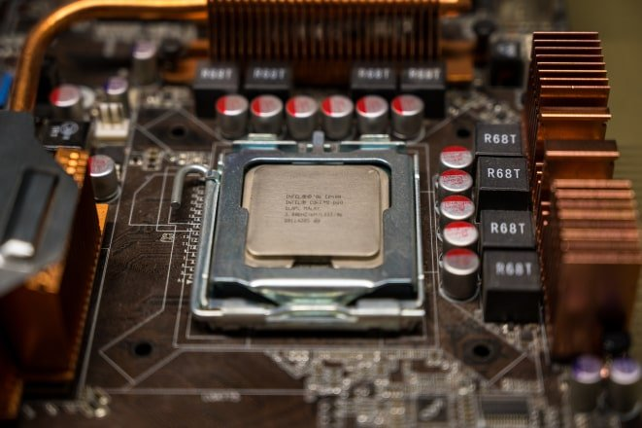
Parts of a Computer
Hardware
Central Processing Unit (CPU)
A central processing unit, also called a central processor or main processor, is the electronic circuitry within a computer that executes instructions that make up a computer program.
The CPU performs basic arithmetic, logic, controlling, and input/output operations specified by the instructions.
The speed and power of a computer significantly depend on the CPU.
CPU is placed on the motherboard.

Slide 20
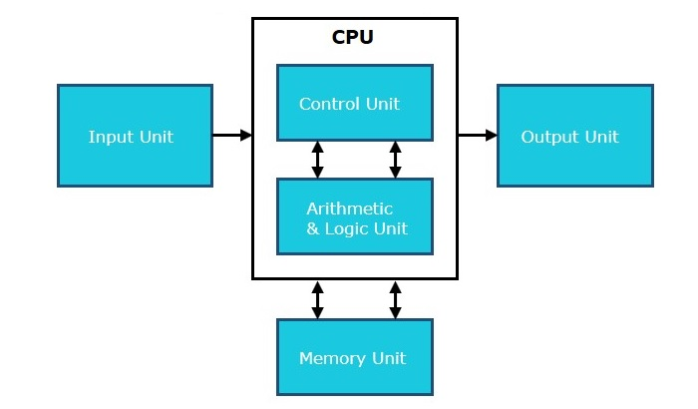
Architectural Diagram of CPU

Slide 21
Architectural Diagram of CPU cont.
Memory or Storage Unit
This unit can store instructions, data and intermediate results.
This unit supplies information to other units of the computer when needed.
It is also known as internal storage unit or the main memory or the primary storage or RAM.
Responsibilities
Stores all the data and the instructions required for processing.
Stores intermediate results of processing.
Stores the final results of processing before these results are released to an output device.

Slide 22
Architectural Diagram of CPU cont.
Control Unit
This unit controls the operations of all parts of the computer but does not carry out any actual data processing operations.
Responsibilities
Control the transfer of data and instructions among other units of a computer.
Manages and coordinates all the units of the computer.
Communicates with input/output devices for transfer of data or results from storage.

Slide 23
Architectural Diagram of CPU cont.
Arithmetic Logic Unit (ALU)
Arithmetic Section
Function of arithmetic section is to perform arithmetic operations like addition, subtraction, multiplication and division.
All complex operations are done by making repetitive use of the above operations.
Logic Section
Function of logic section is to perform logic operations such as comparing, selecting, matching and merging of data.

Slide 24
Types of Processor
Single Core Processor
Single Core processor is a microprocessor with a single core on a chip, running a single thread at any one time.
Dual Core Processor
Dual core processor contains two processors or two execution cores in the same integrated circuit.
Quad Core Processor
Quad core processor is a chip with four independent units called cores.

Slide 25
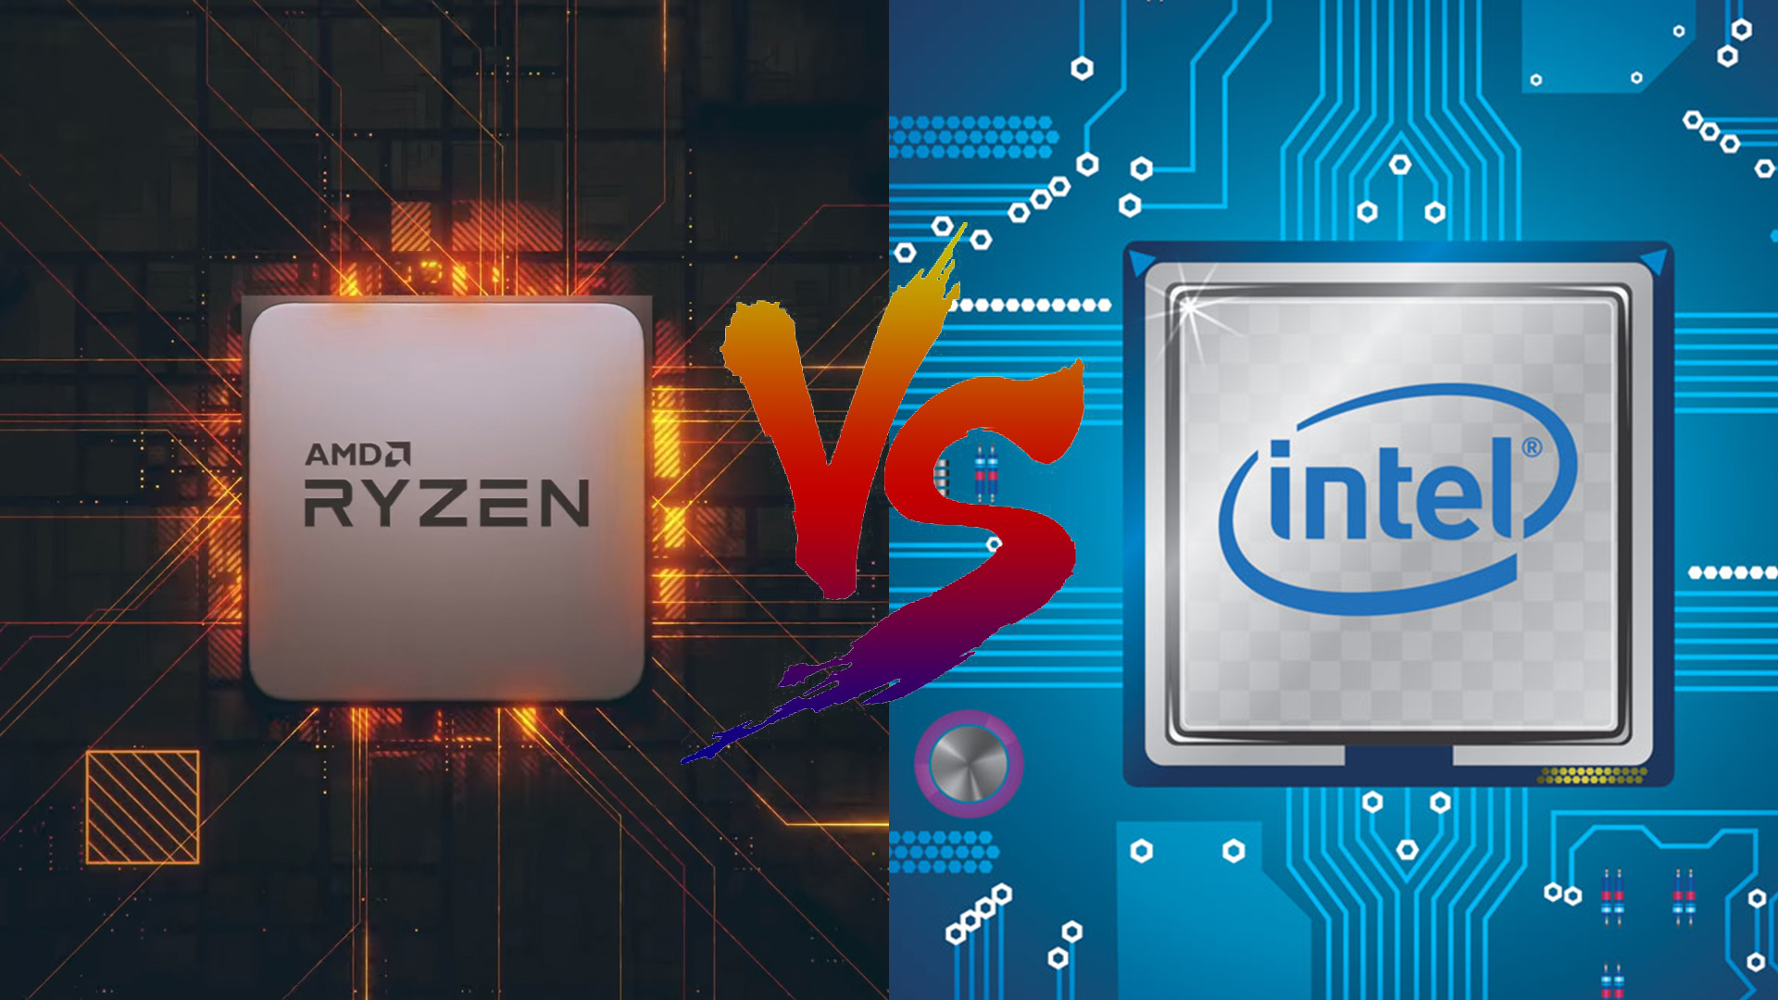
Types of Processor

Slide 26
Parts of a Computer
Hardware
Hardware can be further divided into
Input Devices
Keyboard
Mouse
Barcode Reader
Scanner
Output Devices
Monitor
Printer
Speaker
Earphone

Slide 27
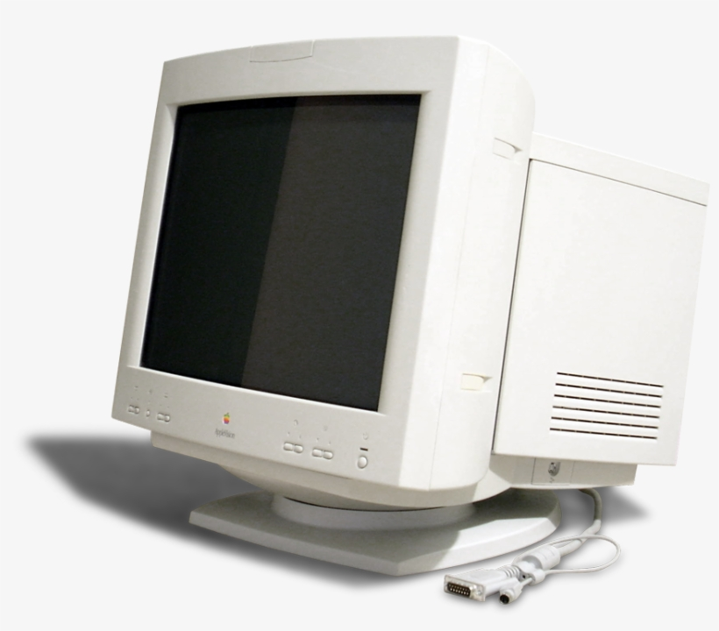
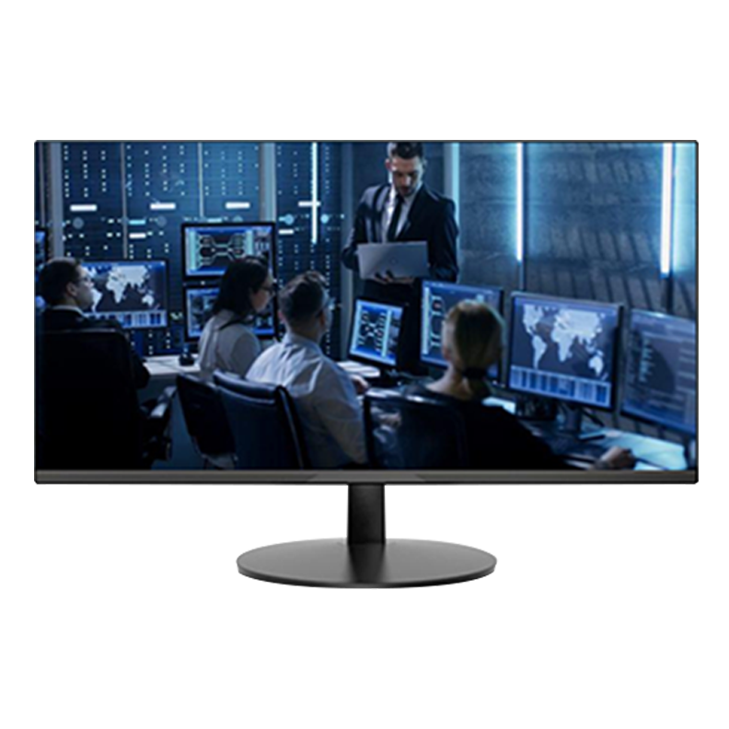
Monitor
Monitor, commonly called as Visual Display Unit (VDU), are the main output device of a computer.
It forms images from tiny dots, called pixels that are arranged in a rectangular form.
The sharpness of the image depends upon the number of pixels.
There are two kind of viewing screen used for monitors
Cathode Ray Tube (CRT) monitors
Flat panel display

Slide 28
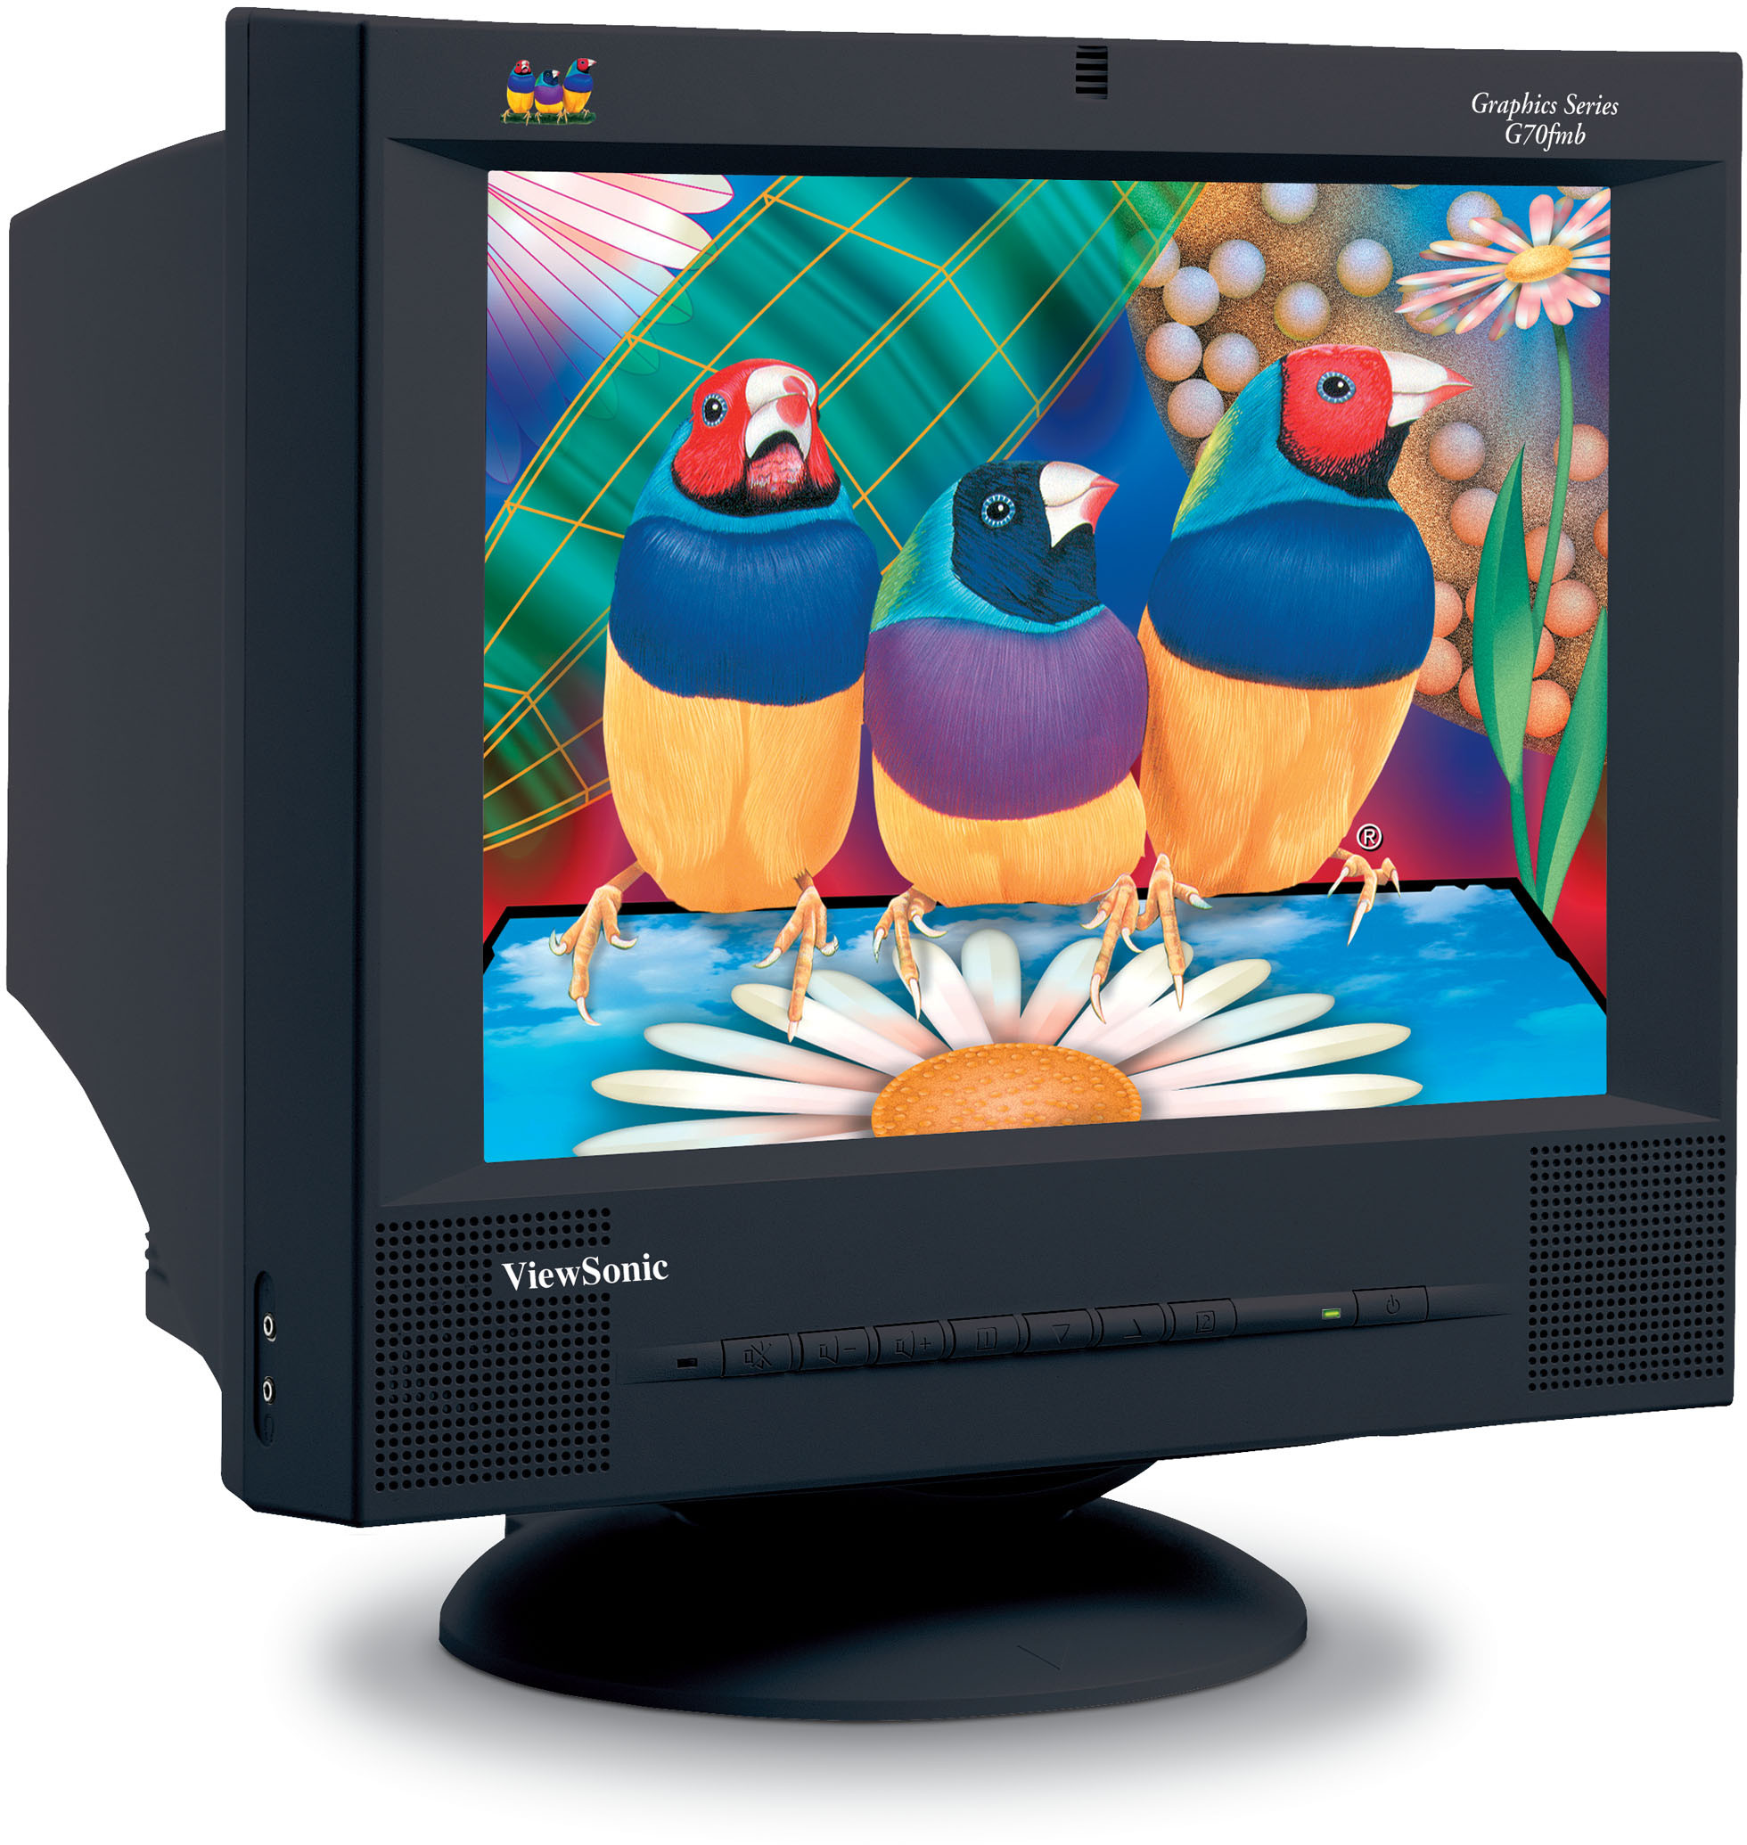
Types of Monitors
Cathode Ray Tube (CRT) Monitors
It uses a beam of electrons to create an image on the screen.
It comprises the guns that fire a beam of electrons inside the screen.
The electron beams repeatedly hit the surface of the screen.
These guns are responsible for generating RGB colors and more other colors can be generated with the help of combining these three colors.

Slide 29
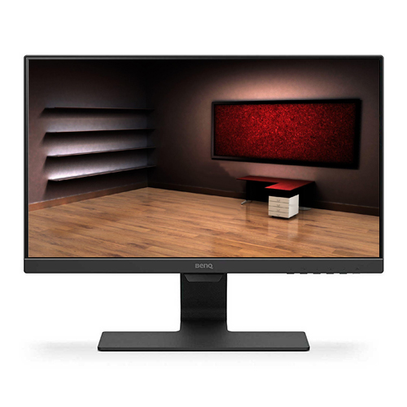
Types of Monitors
Liquid Crystal Display (LCD) Monitors
LCD screens contains a substance known as liquid crystal.
The particles of this substance are aligned in a way that the light located backside on the screens (backlight which is fluorescent) , which allow to generate an image or block.
LCD offers a clear picture as compared to CRT monitors.

Slide 30
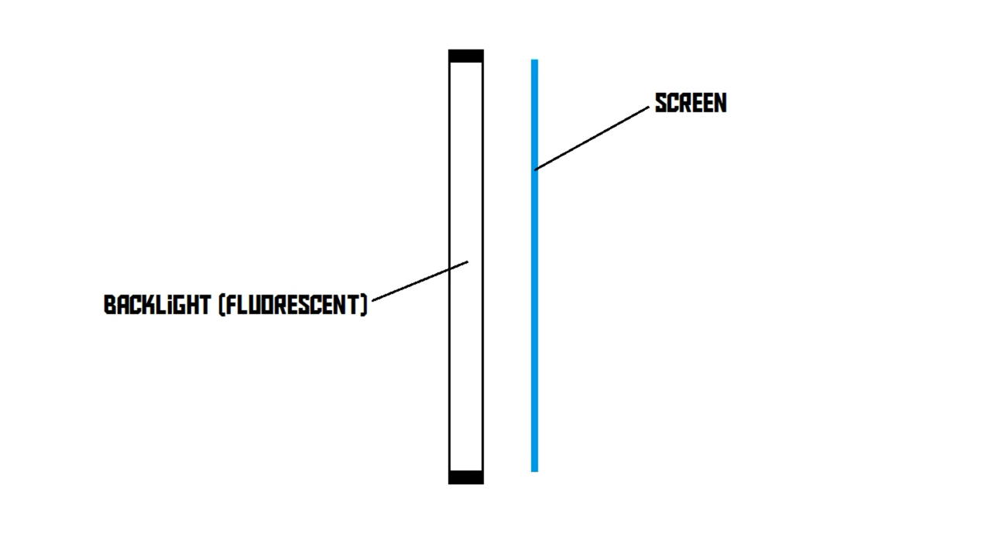
Types of Monitors
Liquid Crystal Display (LCD) Monitors

Slide 31
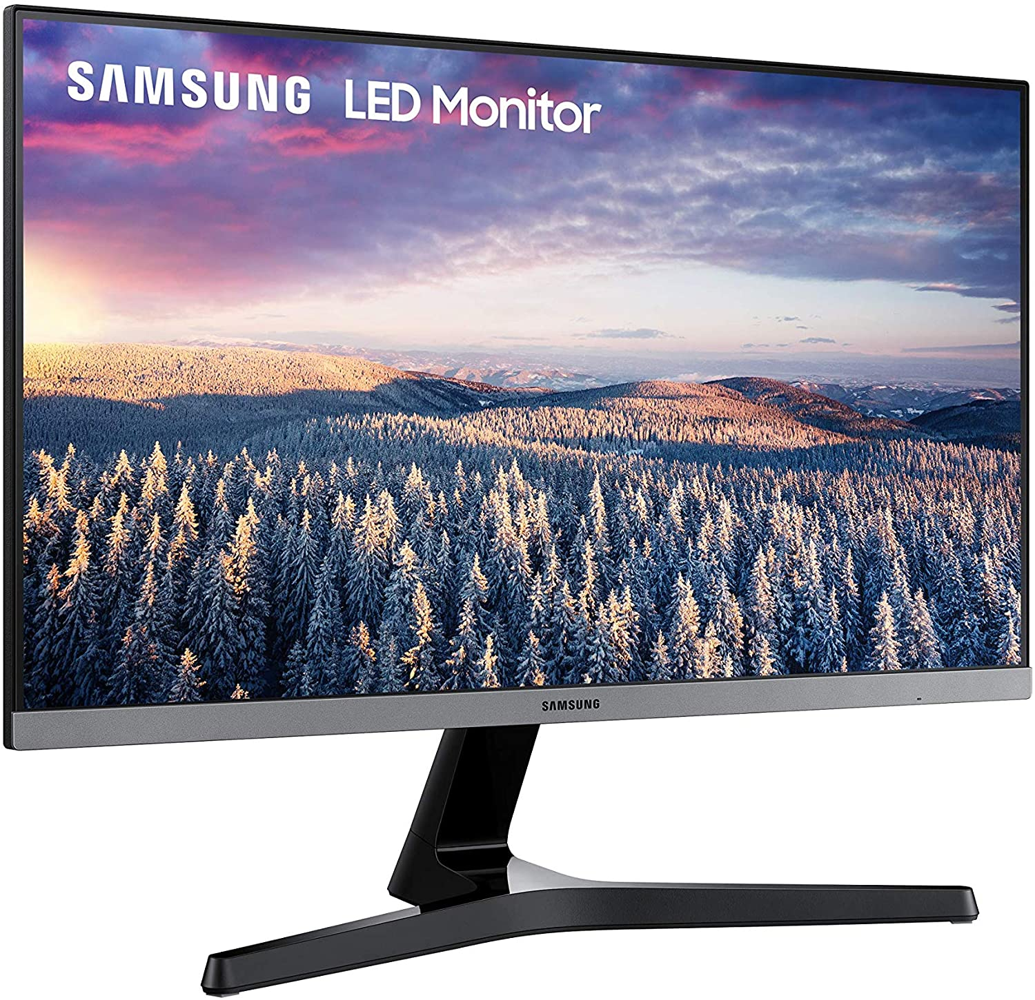
Types of Monitors
LED Monitors
LED stands for light emitting diode display.
As the source of light, it uses a panel of LEDs.
In modern day wide number of electronic devices use LED displays.

Slide 32
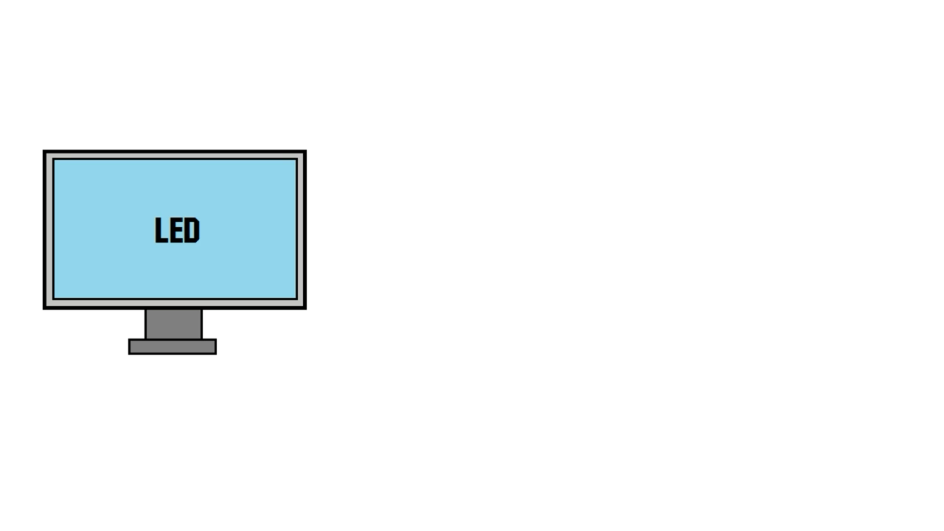
Types of Monitors
LED Monitors

Slide 33

Monitor Refresh Rate

Slide 34
Parts of a Computer
Software
When considering computer software, it can be further divided into
System Software
System software is also known as Operating System which helps to load the basic program automatically as soon as the computer is started.
Application Software
The software which can be used on an installed operating system.

Slide 35


